Slide 1
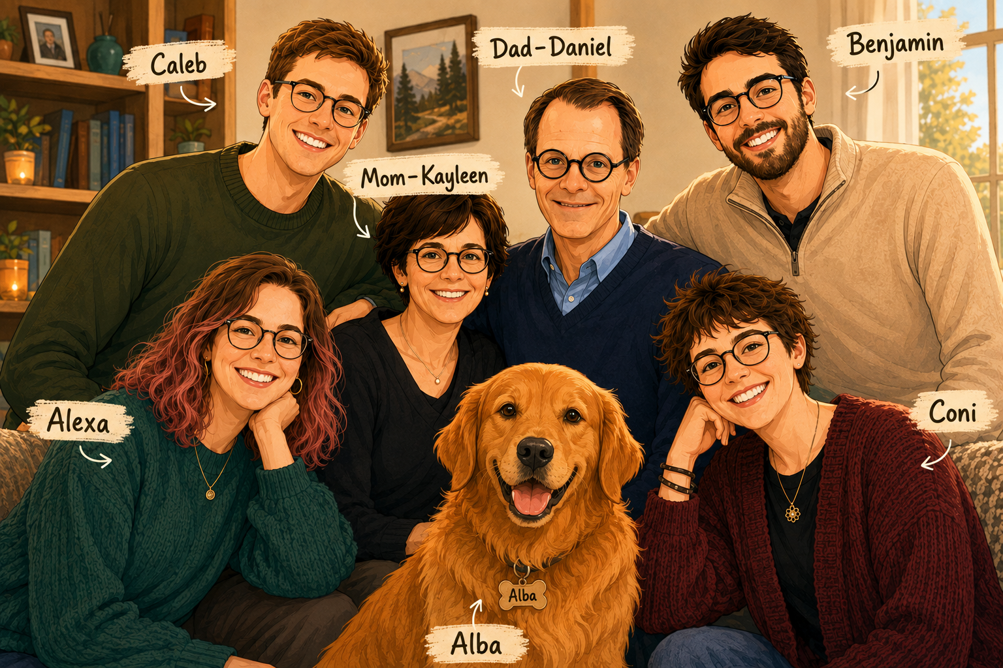

Slide 2
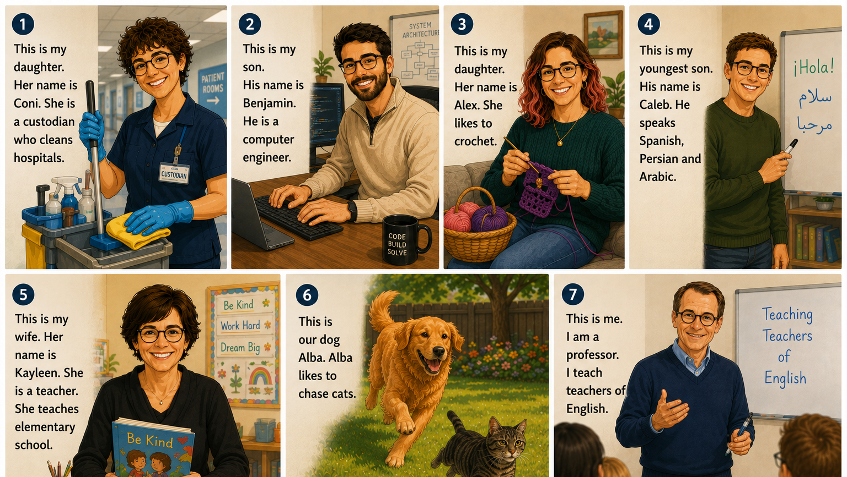

Slide 3

Handout

Slide 4

Activities

Slide 5
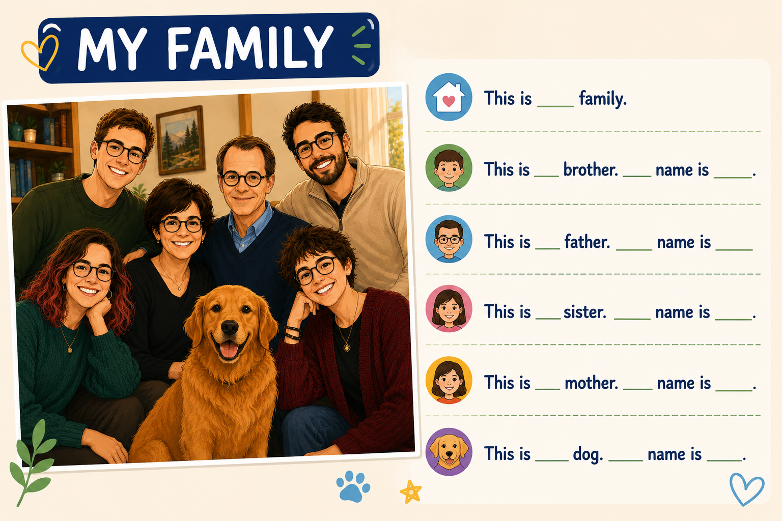
What about YOUR family? Show your picture and talk about them.

